Slide 1
2020 R/V M. Langseth MCS Survey and Piggy-Back Deployments
J. Pablo Canales
Woods Hole Oceanographic Institution
R/V Langseth MCS Survey: Illuminating the Cascadia Plate Boundary Zone and Accretionary Wedge with a Regional-Scale Ultra-Long Offset Multi-Channel Seismic Study
Piggy-Back OBS/OBN Deployment: An Open-Access, Controlled-Source Seismic Dataset Across the Cascadia Accretionary Wedge From Multi-Scale Regional OBS and Focused Large-N Nodal Arrays
Piggy-Back Onshore Deployment: Cascadia2020: Investigating Subduction Zone Segmentation with a 3D High-Resolution Vp Model
Pacific Northwest Earthquake Science Workshop
Nov. 5, 2019, Univ. of Washington, Seattle

Slide 2
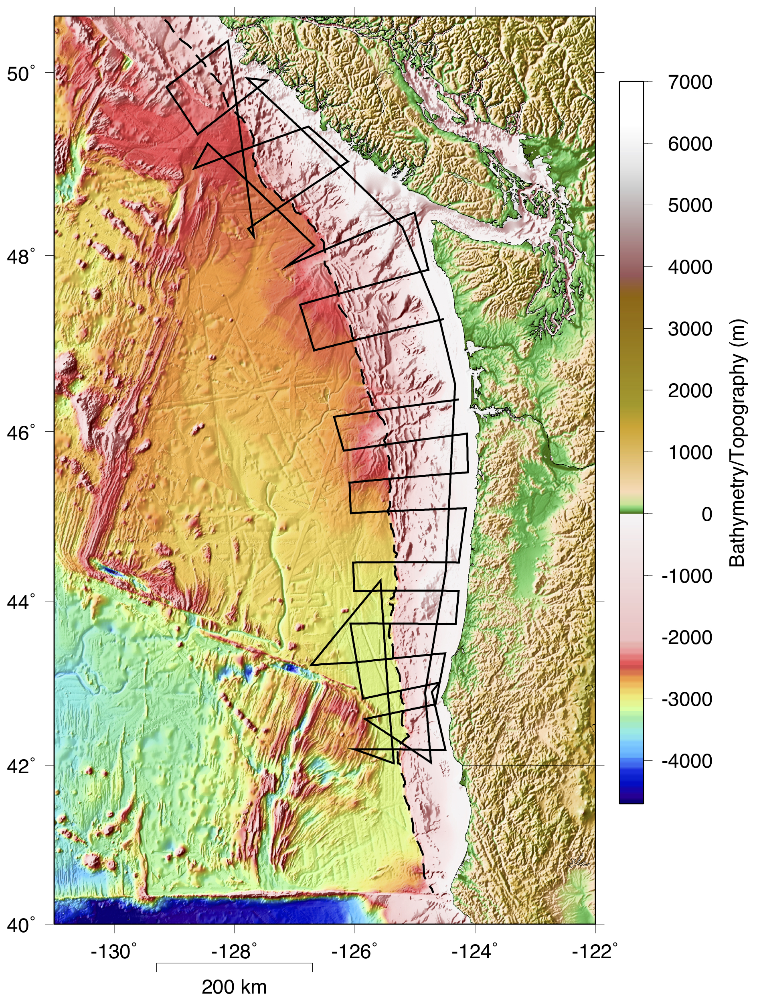
Illuminating the Cascadia Plate Boundary Zone and Accretionary Wedge with a Regional-Scale Ultra-Long Offset Multi-Channel Seismic Study
PI: S. Carbotte (LDEO)
Co-PIs: J.P. Canales (WHOI)
S. Han (UTIG)
M. Nedimović (Dal. Univ.)
A. Calvert (Simon Fraser Univ.)
GOAL: Acquisition and processing of ultra-long-offset (15 km) MCS data to characterize subducting plate and accretionary wedge structure, and properties of the megathrust.
SCIENCE QUESTIONS
Are there any systematics in the structure and properties of the incoming Juan de Fuca plate, the megathrust zone, and accretionary wedge associated with inferred paleo-rupture segmentation?
Are there down-dip variations in megathrust geometry and reflectivity indicative of transitions in fault properties, and what are the properties of the potentially tsunamigenic shallow portion of the megathrust?
OBJECTIVES
Deformation and topography of the incoming plate.
Depth, topography and reflectivity of the megathrust.
Sediment properties and amount of sediment subduction.
Structure and evolution of the accretionary wedge, including geometry/reflectivity of fault networks.
How these properties vary along strike and down dip across what may be the full width of the seismogenic zone at Cascadia.

Slide 3
Illuminating the Cascadia Plate Boundary Zone and Accretionary Wedge with a Regional-Scale Ultra-Long Offset Multi-Channel Seismic Study
PI: S. Carbotte (LDEO)
Co-PIs: J.P. Canales (WHOI)
S. Han (UTIG)
M. Nedimović (Dal. Univ.)
A. Calvert (Simon Fraser Univ.)
ACQUISITION
R/V M. Langseth, June 1-July 10, 2020
15-km-long streamer, 1,200 channels, 12-m depth
Source: 6,600 cu.in, 37.5 m shot spacing, 12-m depth
15-s records, 2 ms sampling rate
PROCESSING
At-sea: stacking and post-stack time migration.
Industry partner: pre-stack depth migration.
DATA AVAILABILITY
Raw shot gathers and shipboard stack/migrations.
Processed PSDM after completion (end of Year 2 approx.)

Slide 4
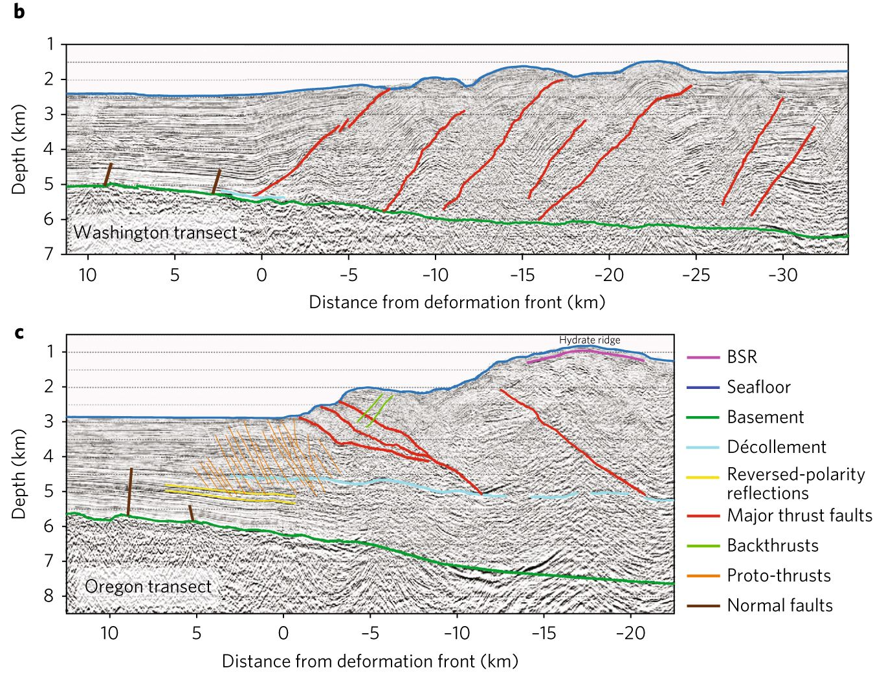
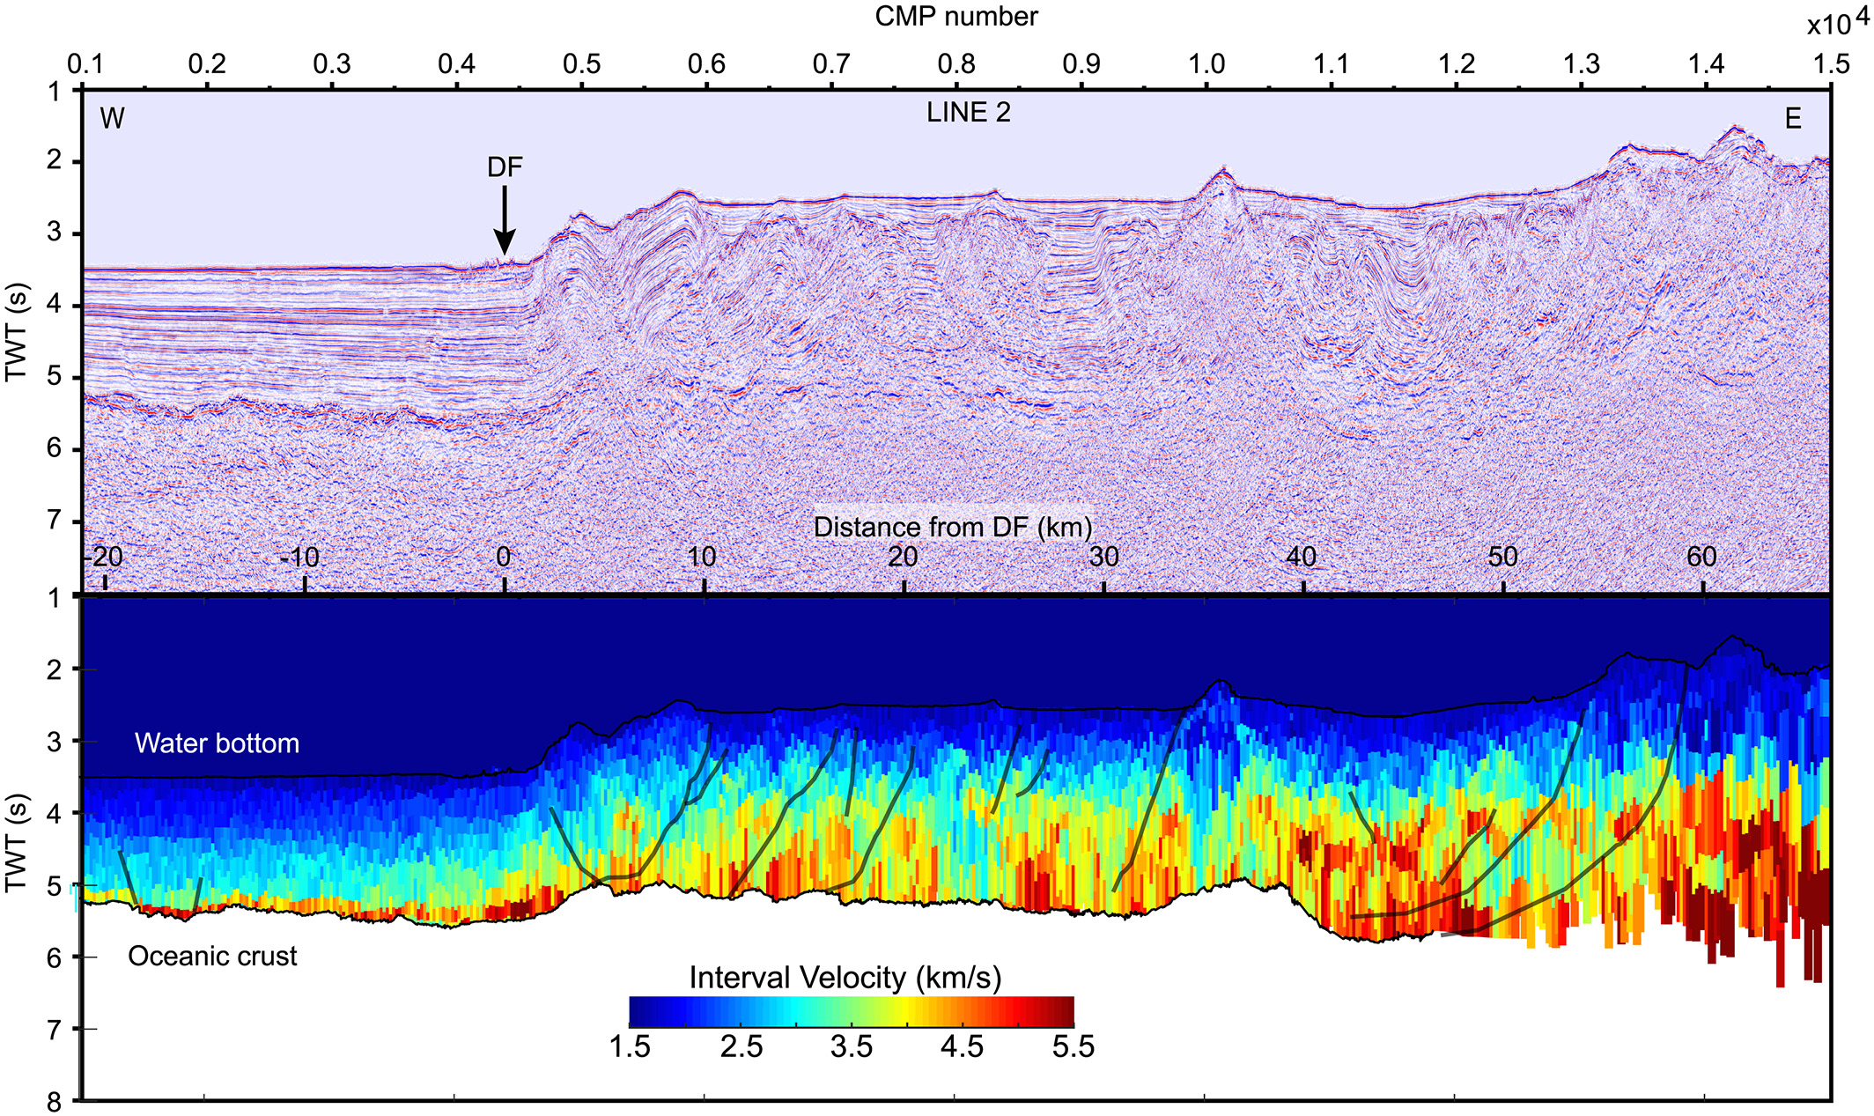
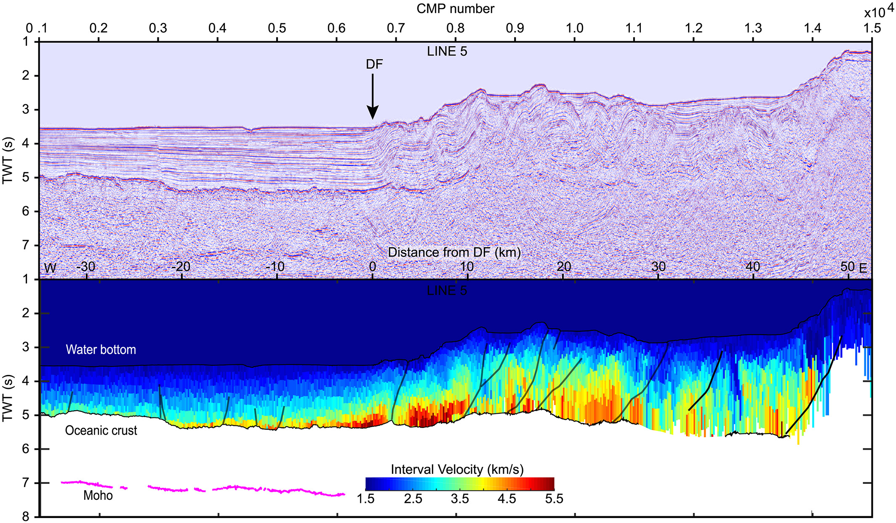
Illuminating the Cascadia Plate Boundary Zone and Accretionary Wedge with a Regional-Scale Ultra-Long Offset Multi-Channel Seismic Study
Deformation and topography of the incoming plate.
Sediment properties and amount of sediment subduction.
Structure and evolution of the accretionary wedge.
R2T results
Han et al., 2017
COAST results
Peterson & Keranen, 2019

Slide 5
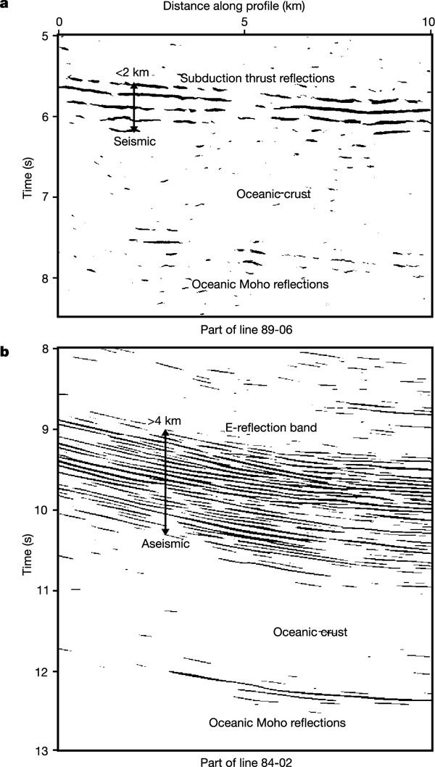
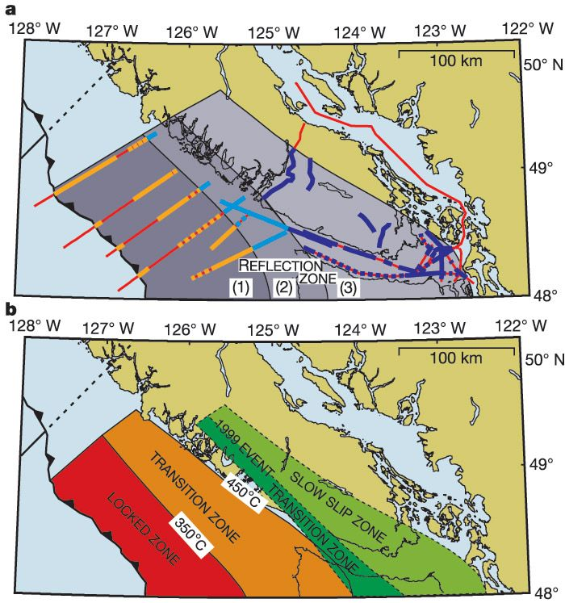
Illuminating the Cascadia Plate Boundary Zone and Accretionary Wedge with a Regional-Scale Ultra-Long Offset Multi-Channel Seismic Study
Depth, topography and reflectivity of the megathrust.
Nedimović et al., 2003

Slide 6
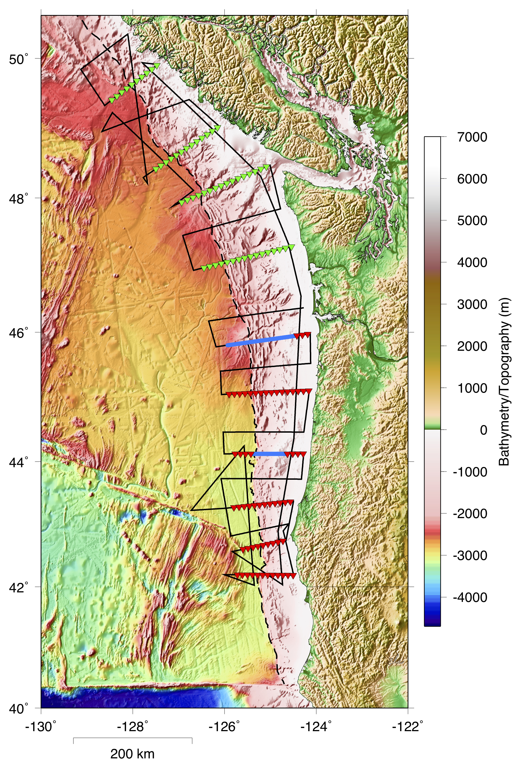
An Open-Access, Controlled-Source Seismic Dataset Across the Cascadia Accretionary Wedge From Multi-Scale Regional OBS and Focused Large-N Nodal Arrays
With Support from USGS Subduction Zone Marine Geohazards Project
PI: J.P. Canales (WHOI)
Co-PIs: N. Miller (USGS)
D. Lizarralde (WHOI)
GOAL: Acquisition of an open-access, marine wide-angle seismic reflection/refraction dataset across the Cascadia accretionary wedge.
EXPECTED OUTCOMES
A margin-scale model (~100-km lateral resolution).
Regional, intermediate-resolution models (~10-km lateral resolution) across 11 transects from the abyssal plain to the continental shelf.
Local, high-resolution models (hundreds-of-meters lateral resolution) across 2 transects representative of distinct accretionary wedge structural styles.
SOME SCIENCE QUESTIONS
Variations in accretionary wedge site response.
Linkages between paleo great earthquakes and distribution of turbidites.
Accretionary sediment properties (Vp, Vs, density, porosity, and fluid pore pressure) indicative of fluid expulsion and/or retention, drainage networks, and their relation to wedge structural style (e.g., seaward vs. landward thrusting).

Slide 7
An Open-Access, Controlled-Source Seismic Dataset Across the Cascadia Accretionary Wedge From Multi-Scale Regional OBS and Focused Large-N Nodal Arrays
ACQUISITION
Four legs on R/V Oceanus
Four-channel, short-period OBSs
OBSIC, free fall, 9-10 km spacing
Leg 1: May 3-7, 2020
60 OBS deployments
Leg 3: June 16-July 7, 2020
Recovery 60 OBSs, deployment of 55 OBSs
Four-channel ocean bottom nodes
InApril, ROV, 500 meter spacing
Leg 2: May 14-27, 2020
350 node deployments:
Leg 4: July 13-July 26, 2020
Recovery 350 nodes
DATA AVAILABILITY
Raw time series and SEGY: immediately after processing and quality control.

Slide 8
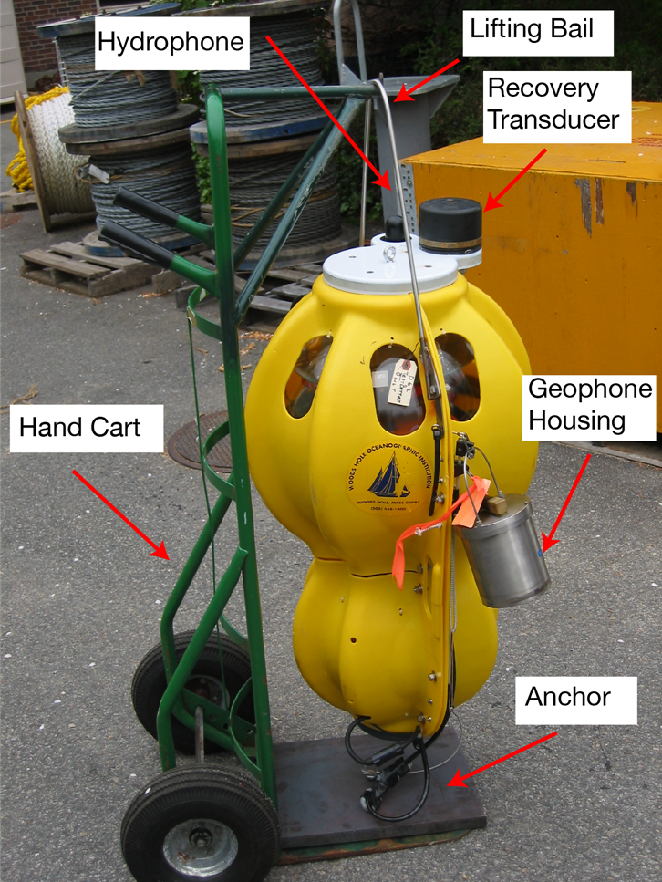
An Open-Access, Controlled-Source Seismic Dataset Across the Cascadia Accretionary Wedge From Multi-Scale Regional OBS and Focused Large-N Nodal Arrays
OBSIC Short-period OBSs
WHOI D2, SIO LC4x4
Hydrophone: 5 Hz low-freq. corner
Geophone: 3 component 4.5 Hz
ACQUISITION
Four legs on R/V Oceanus
Four-channel, short-period OBSs
OBSIC, free fall, 9-10 km spacing
Leg 1: May 3-7, 2020
60 OBS deployments
Leg 3: June 16-July 7, 2020
Recovery 60 OBSs, deployment of 55 OBSs
Four-channel ocean bottom nodes
InApril, ROV, 500 meter spacing
Leg 2: May 14-27, 2020
350 node deployments:
Leg 4: July 13-July 26, 2020
Recovery 350 nodes
DATA AVAILABILITY
Raw time series and SEGY: immediately after processing and quality control.
InApril A3000 node
Hydrophone: 3 Hz - 30 kHz
Geophone: 3 component ION SM6 omni-directional, 14 Hz natural freq.
Depth: 3000 m max.
Pelagic Research Services
ROV Odysseus

Slide 9
An Open-Access, Controlled-Source Seismic Dataset Across the Cascadia Accretionary Wedge From Multi-Scale Regional OBS and Focused Large-N Nodal Arrays
ACQUISITION
Four legs on R/V Oceanus
Four-channel, short-period OBSs
OBSIC, free fall, 9-10 km spacing
Leg 1: May 3-7, 2020
60 OBS deployments
Leg 3: June 16-July 7, 2020
Recovery 60 OBSs, deployment of 55 OBSs
OBSIC Short-period OBSs
WHOI D2, SIO LC4x4
Hydrophone: 5 Hz low-freq. corner
Geophone: 3 component 4.5 Hz

Slide 10
An Open-Access, Controlled-Source Seismic Dataset Across the Cascadia Accretionary Wedge From Multi-Scale Regional OBS and Focused Large-N Nodal Arrays
ACQUISITION
Four legs on R/V Oceanus
Four-channel ocean bottom nodes
InApril, ROV, 500 meter spacing
Leg 2: May 14-27, 2020
350 node deployments:
Leg 4: July 13-July 26, 2020
Recovery 350 nodes
DATA AVAILABILITY
Raw time series and SEGY: immediately after processing and quality control.
InApril A3000 node
Hydrophone: 3 Hz - 30 kHz
Geophone: 3 component ION SM6 omni-directional, 14 Hz natural freq.
Depth: 3000 m max.
Pelagic Research Services
ROV Odysseus

Slide 11
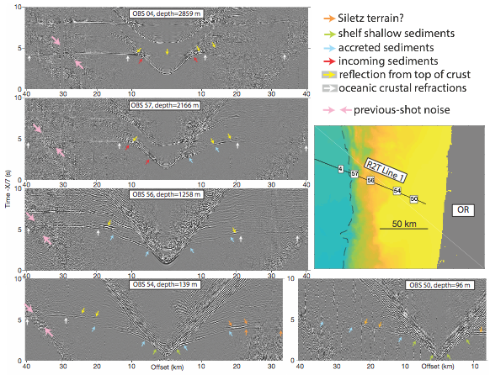
An Open-Access, Controlled-Source Seismic Dataset Across the Cascadia Accretionary Wedge From Multi-Scale Regional OBS and Focused Large-N Nodal Arrays
Expectations on Data Quality

Slide 12
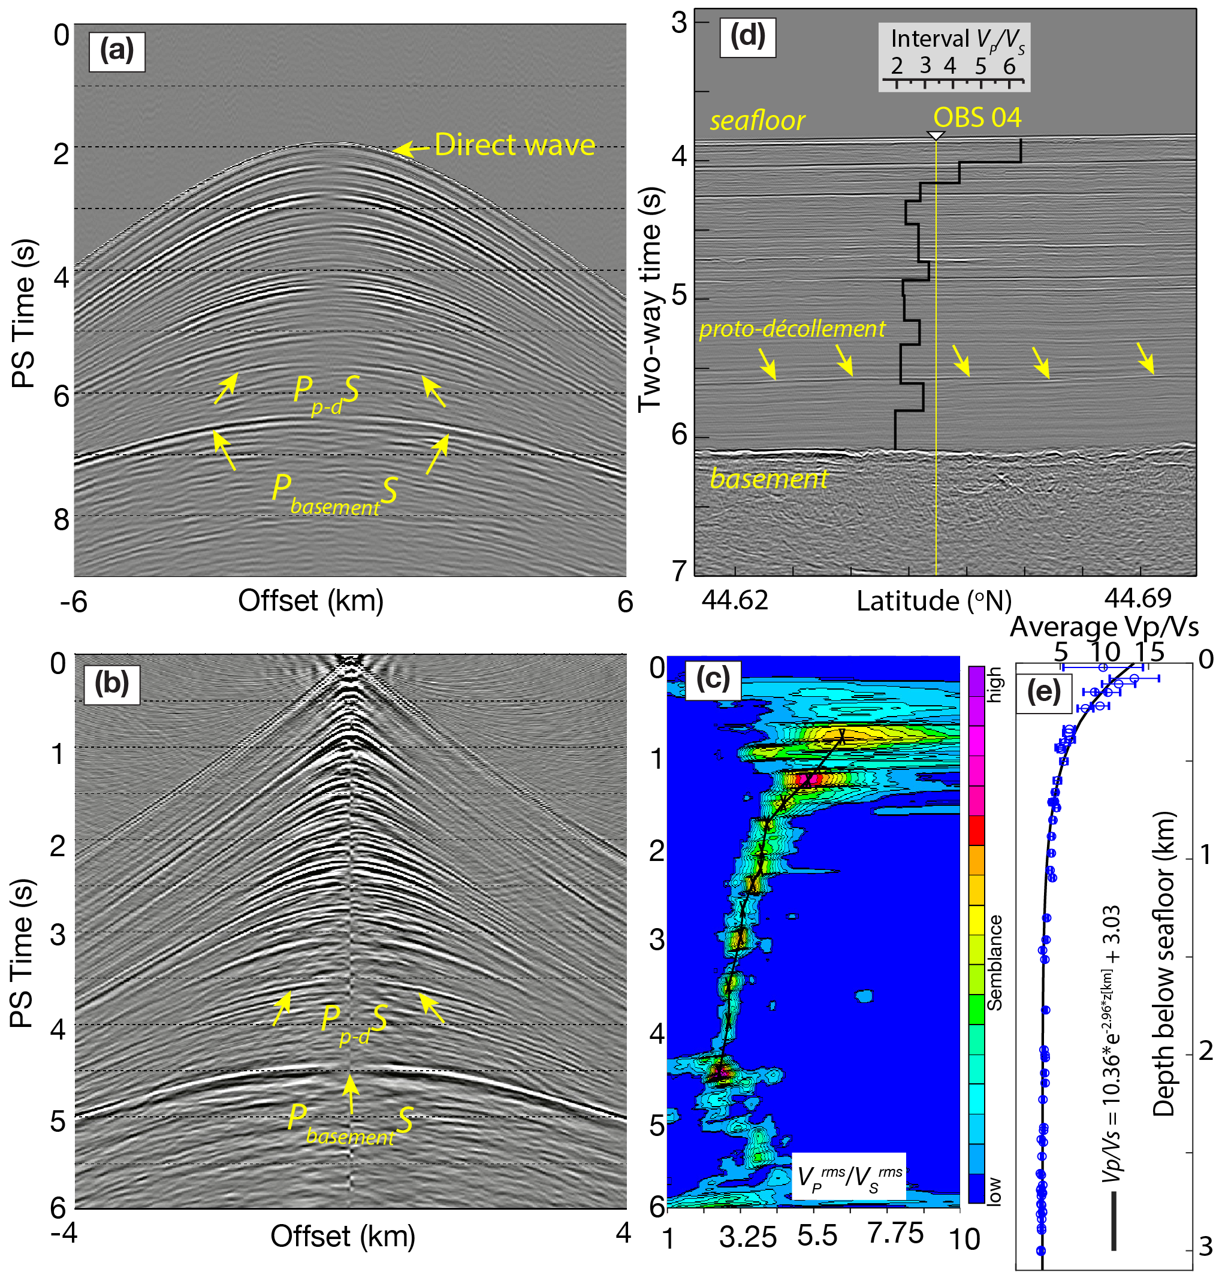
An Open-Access, Controlled-Source Seismic Dataset Across the Cascadia Accretionary Wedge From Multi-Scale Regional OBS and Focused Large-N Nodal Arrays
Expectations on Data Quality
Zhu et al., in prep.

Slide 13
Cascadia2020: Investigating Subduction Zone Segmentation with a 3D High-Resolution Vp Model
(pending proposal)
Co-PIs: A. Trehu (OSU)
K. Davenport (OSU)
K. Ward (SDSMT)
E. Hooft (Univ. OR)
GOAL: Acquisition of an onshore/offshore wide-angle seismic reflection/refraction dataset, and development of a 3-D Vp model of the Cascadia fore-arc and subducting plate geometry.
photo courtesy of K. Ward
figure courtesy of A. Trehu

